Slide 1
Group Based Multifatorial Evolutionary Algorithm

Slide 2
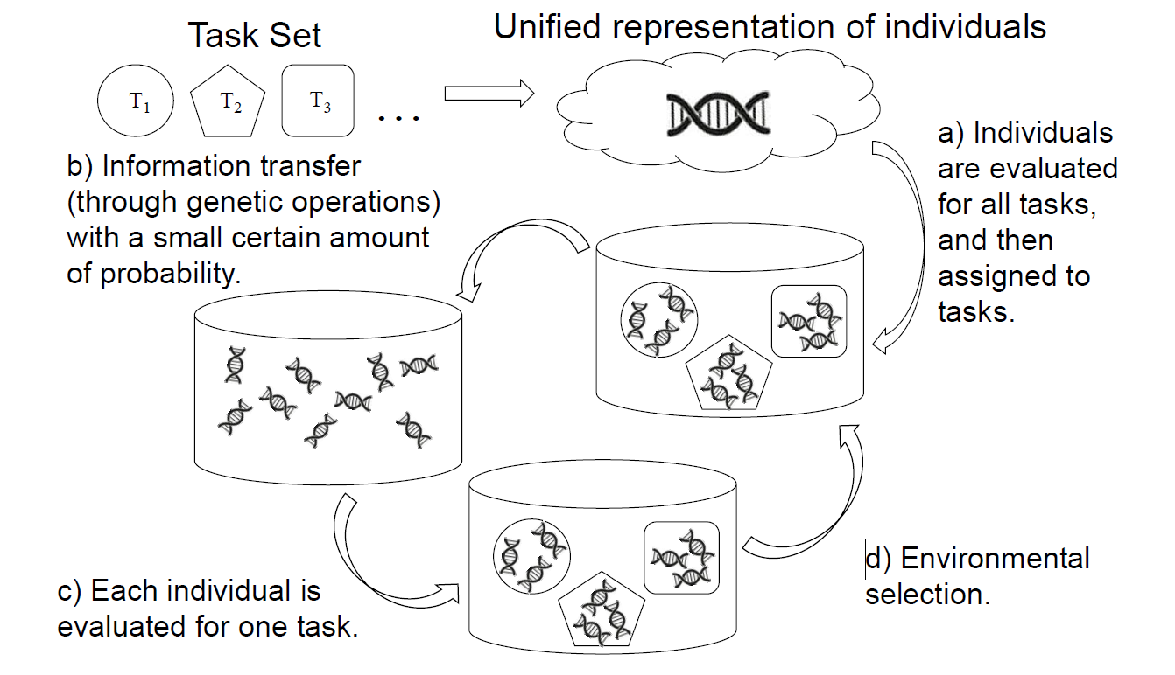
The MFEA main procedures.
The MFEA main procedures.

Slide 3
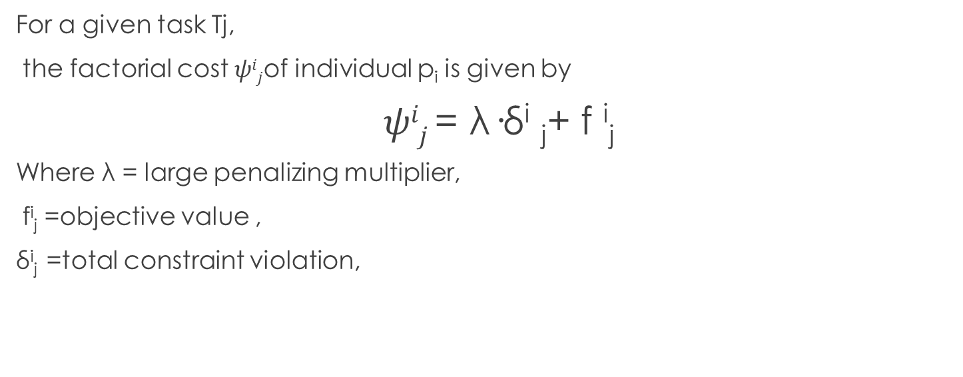
Factorial Cost
For a given task Tj,
the factorial cost $ψij$of individual p_{i} is given by
$ψij$= λ·δ^{i} _{j}+ f ^{i}_{j}
Where λ = large penalizing multiplier,
f^{i}_{j} =objective value ,
δ^{i}_{j} =total constraint violation,

Slide 4
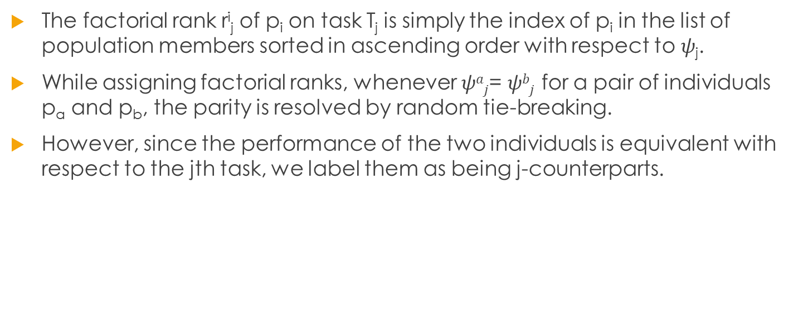
Factorial Rank
The factorial rank r^{i}_{j} of p_{i} on task T_{j} is simply the index of p_{i} in the list of population members sorted in ascending order with respect to $ψ$_{j}.
While assigning factorial ranks, whenever $ψaj$= $ψbj$ for a pair of individuals p_{a} and p_{b}, the parity is resolved by random tie-breaking.
However, since the performance of the two individuals is equivalent with respect to the jth task, we label them as being j-counterparts.

Slide 5
Scalar Fitness and Skill Factor
The list of factorial ranks{r^{i}₁, r^{i}₂, . . . , r^{i}_{K} } of an individual pi is reduced to a scalar fitness ϕ_{i} based on its best rank over all tasks; i.e., ϕ_{i} =1/ min_{j∈{1,...,K}{rij}}.
The skill factor τ_{i} of p_{i} is the one task, amongst all other tasks in MFO, on which the individual is most effective, i.e., τ_{i} = argmin_{j}{r^{i}_{j}}, where j ∈ {1, 2, . . . ,K}.

Slide 6
Genetic Mechanisms
Crossover
Mutation
Assortative Mating
Random Mating Probability(RMP)

Slide 7
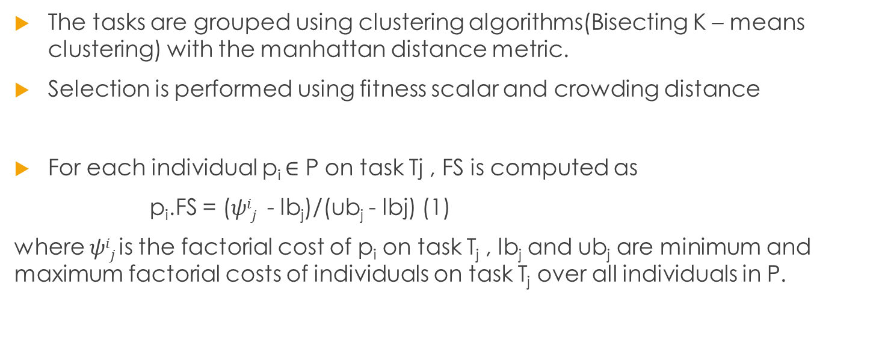
Grouping and Selection
The tasks are grouped using clustering algorithms(Bisecting K – means clustering) with the manhattan distance metric.
Selection is performed using fitness scalar and crowding distance
For each individual p_{i} ∈ P on task Tj , FS is computed as
p_{i}.FS = ($ψij$ - lb_{j})/(ub_{j} - lbj) (1)
where $ψij$is the factorial cost of p_{i} on task T_{j} , lb_{j} and ub_{j} are minimum and maximum factorial costs of individuals on task T_{j} over all individuals in P.

Slide 8
Experimental Study
Four Benchmark functions are selected for cross domain experiments.
The functions include Griewank function, Ackley Function, Rastrigan Function, Weierstrass Function .
the performance of a single task EA (denoted as ST) is compared to the MFEA variants. MF denotes MFEA, GMF denotes MFEA plus task grouping strategy, and GMF+S denotes GMF integrated with the new selection criterion.
All the MFEA variants defeat ST after several generations because ST is quickly trapped in a local optimum. GMFEA variants exhibit a better convergence compared to MF, while the performance of GMF+S is between GMF and MF.

Slide 9
Applications
Strong practical motivation for the MFO paradigm is derived from the rapidly expanding popularity of the cloud computing industry.
In particular, we imagine a cloud-based on-demand service providing customers with access to state of-the-art optimization software.
In this regard, we notice that a cloud service faces the natural phenomenon wherein multiple optimization tasks can be received from multiple users at the same time.
These tasks can either have similar properties or belong to entirely different domains.
Therefore, for the MFEA to be deployable as a cloud-based multitasking engine, it must possess cross-domain optimization capabilities(i.e., the ability to simultaneously handle continuous as well as discrete optimization problems).

Slide 10
Future Work
The group-based is scalable to deal with the optimization of a significant number of tasks that can’t be solved by the plain MFEA. The grouping is carefully designed using clustering algorithms and the selection is based on two well-formulated components. The performance is demonstrated by different angles over multiple domains.
The results suggest effective performance with good efficiency achieved by GMFEA, which leads to promising solutions to a general many-task solver in many applications like a cloud platform. But the algorithm cannot handle well the situation that few similar tasks exist in the task set, e.g. in an extreme circumstance that each group contains only one task. We will deal with this situation in the future work.

Slide 11
References
[Gupta et al., 2016] Abhishek Gupta, Yew Soon Ong, and Liang Feng. Multifactorial Evolution: Toward Evolutionary Multitasking. IEEE Transactions on Evolutionary Computation, 20(3):343–357, 2016.
Jing Tang, Yingke Chen, Zixuan Deng, Yanping Xiang, Colin Paul Joy, A Group-based Approach to Improve Multifactorial Evolutionary Algorithm, IJCAI 2018 Proceedings.

